Slide 1
Corporate and Institutional Banking ( C & IB)
March, 2018

Slide 2
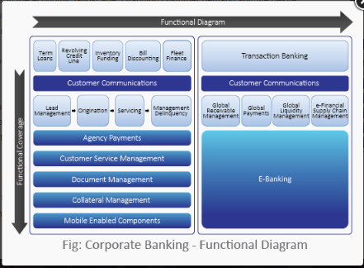
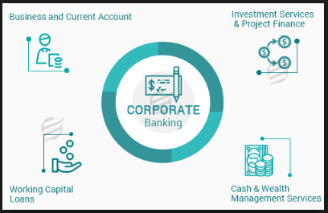
Corporate and Institutional Banking (C & IB)
Corporate Banking: Corporate banking is defined as custom-tailored financing and banking services for corporations. Corporate banking, also known as business banking, refers to the aspect of banking that deals with corporate customers Corporate banking is typically offered by commercial banks, and entails all the services that can be extended on a financial level to corporate entities to ease day-to-day operations. Cash management, working capital loans and commercial mortgages are just some of the products available in this form of banking; some banks even offer financial supply chain optimization.
Major Activities
`

Slide 3
Corporate and Institutional Banking ( C & IB)
Corporate Banking Products and Services:
Loans and other credit products: this is typically the biggest area of business within corporate banking, and as noted earlier, one of the biggest sources of profit and risk for a bank.
Treasury and cash management services: used by companies for managing their working capital and currency conversion requirements.
Equipment lending: commercial banks structure customized loans and leases for a range of equipment used by companies in diverse sectors such as manufacturing, transportation and information technology.
Commercial real estate: services offered by banks in this area include real asset analysis, portfolio evaluation, and debt and equity structuring.
Trade finance: involves letters of credit, bill collection and factoring.
Employer services: services such as payroll and group retirement plans are typically offered by specialized affiliates of a bank.

Slide 4
Corporate and Institutional Banking ( C & IB)
Institutional Banking: Institutional Banking is a specialized division within a bank that offers a comprehensive suite of products and services for large institutions both locally and abroad. In particular they can provide complex financing and advisory functions for corporate and government clients who may require tailored capital products. In addition they may also advise on surrounding debt, equity capital markets, risk management and transactional banking.
Institutional Banking Example: Institutional banking usually incorporates services such as evaluating mergers & acquisitions, investments and divestments, managing treasuries etc. Institutional banking helps clients to create corporate strategies and develop opportunities for growth on a national and global level. Institutional banking provides clients with expertise, research analysis and result-based methodologies that enable them to make sound financial decisions, suited to their business environment. Banks sometimes tailor their offerings to suit the operations of clients such as those who may have to obtain financing through other avenues as they are dependent on capital or trade flows.
Institutional Banking Services:

Slide 5
Corporate and Institutional Banking ( C & IB)
Institutional Banking Products and Services:

Slide 6
Corporate and Institutional Banking ( C & IB)
Corporate Banks: Major Corporate Banks across the globe
JPMorgan Chase.
Wells Fargo.
Bank of America.
Citigroup.
U.S. Bancorp.
Institutional Banks: Major Corporate Banks across the globe
JPMorgan Chase.
Goldman Sachs.
Bank of America Merrill Lynch.
Morgan Stanley.
Citi Group.
Credit Suisse.
Barclays Investment Bank.
Deutsche Bank.

Slide 7
Corporate and Institutional Banking ( C & IB)
Corporate Banking | Retail Banking | Commercial Banking | Investment Banking | Institutional Banking | Wholesale Banking | Private Banking
Institutional banking: Mainly lending money to large companies. They offer a comprehensive suit of products and services for large companies / corporates
They mainly deal with relationship with banks, financial institutions , security houses, insurance companies, asset management companies and other non-bank finance companies, private equity and venture funds
Corporate banking: mainly lending money to small-middle sized companies.
Investment banking: mainly helping companies to buy other companies or sell the companies themselves, helping the same companies to get debt or equity financing (not necessarily providing them), or making trades in the various finance / stock markets

Slide 8
Corporate and Institutional Banking ( C & IB)

